Slide 1
Content change highlights for LOINC 2.54…plus a few sneak peeks
2/25/2016

Slide 2
Summary of new content in 2.54
2600+ new terms
Lab: ~1000
Clinical: ~1450
Survey: ~230

Slide 3
New lab terms in 2.54
Individual concepts include:
430 chemistry
Including ~130 in CHEM.ESOTERIC class
300 drug/toxicology
80 molecular pathology
70 microbiology
12 pharmacogenomics terms created for the Clinical Pharmacogenetics Implementation Consortium (CPIC)

Slide 4
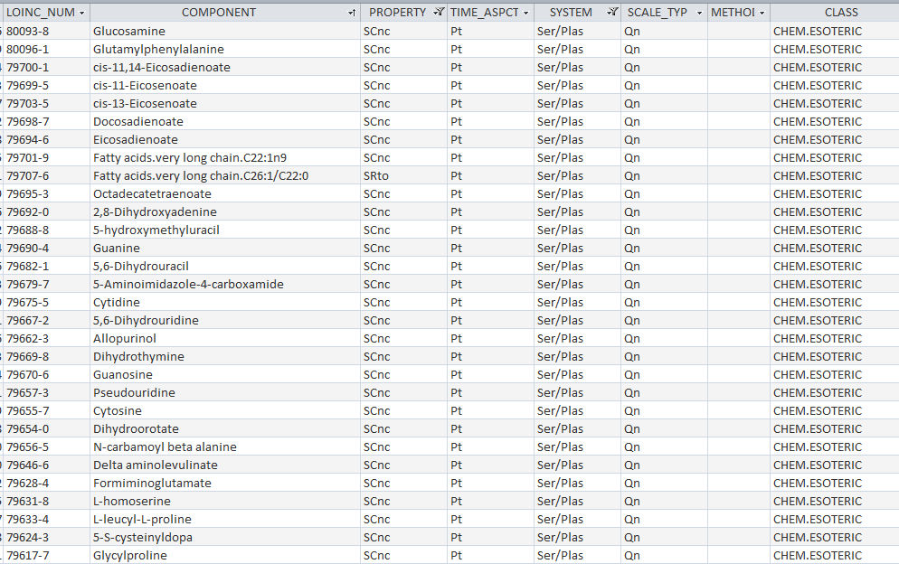
CHEM.ESOTERIC examples

Slide 5
CPIC terms

Slide 6
http://loinc.org/news/new-loinc-codes-for-reporting-pharmacogenomics-results-can-enable-evidence-based-clinical-decision-making.html/

Slide 7
Zika virus terms – 2/2016
80618-2 Zika virus IgM Ab [Units/volume] in Cerebral spinal fluid by Immunoassay
80619-0 Zika virus IgM Ab [Units/volume] in Serum by Immunoassay
80620-8 Zika virus neutralizing antibody [Titer] in Serum by Neutralization test
80621-6 Zika virus neutralizing antibody [Titer] in Cerebral spinal fluid by Neutralization test
80622-4 Zika virus neutralizing antibody [Titer] in Serum by Neutralization test --1st specimen
80623-2 Zika virus neutralizing antibody [Titer] in Serum by Neutralization test --2nd specimen
80624-0 Zika virus neutralizing antibody [Titer] in Cerebral spinal fluid by Neutralization test --1st specimen
80625-7 Zika virus neutralizing antibody [Titer] in Cerebral spinal fluid by Neutralization test --2nd specimen

Slide 8
New lab panels in 2.54
40+ panels
Mucopolysaccharidosis type I (MPS I) newborn screening panel
Purine & Pyrimidine panels for urine, ser/plas and CSF
Amino acid panels for urine, ser/plas and CSF
Peritoneal equilibration test panel
Prolactin isoforms panel
Enteric pathogens panel
Parent drug and trough panels for anti-epileptic drugs and others
Cold agglutinin panel
Serial sputum smears for diagnosing pulmonary tuberculosis panel
Respiratory bacteria and viruses DNA and RNA panel
HEDIS 2016 Value sets

Slide 9
~1450 new clinical terms
340+ document-related codes
310 terms for IEEE Rosetta 11073 10101, including EKG, invasive blood pressure monitoring, anesthesia gas delivery and respiratory monitoring, and infant microenvironment
189 terms for NIH/NEI's National Ophthalmic Disease Genotyping and Phenotyping Network (eyeGENE)
190 terms for DICOM Supplement 169 (“Simplified Adult Echocardiography Report”), based on American Society of Echocardiography adult echo guidelines
81 terms for Japanese Circulation Society, mainly angiography, echo, and other concepts for reporting cardiac procedure results in HL7 CDA
64 new terms for Radiology, including CT terms to complete RadLex CT mappings
Boston University Activity Measure for Post-Acute Care (AM-PAC)
Care Connections Neuromuscular and Orthopedic functional index

Slide 10
IEEE update
IEEE-Regenstrief MOU …finally signed October 2015!
http://standards.ieee.org/news/2015/ehealth.html

Slide 11
IEEE update (cont.)
300+ new LOINC concepts corresponding to medical device concepts in the IEEE 11073 10101 standard in 2.54
~250 more LOINC concepts corresponding to the 11073 10101a standard are essentially ready, need final review
LOINC IEEE Mapping table was part of the official LOINC release and is available on the LOINC website
NIST RTMMS site will also have mapping table
2/2016 – has been loaded, not live yet
IEEE codes (“MDC_” and numeric) included in LOINC as related codes

Slide 12
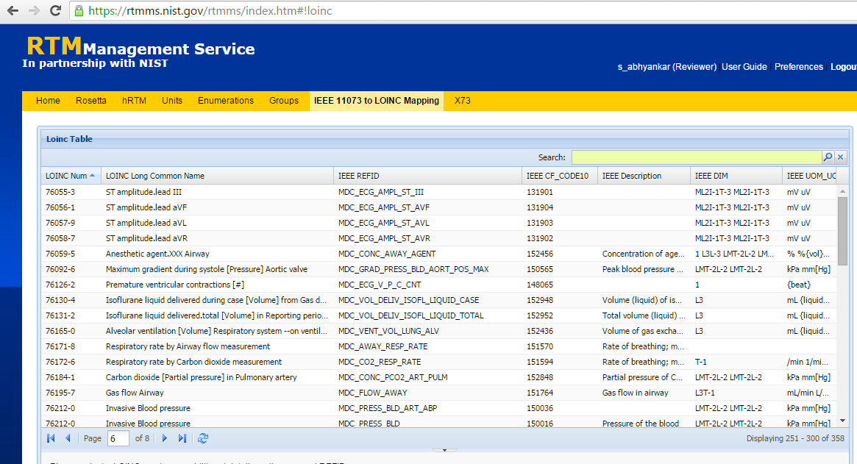
LOINC in RTMMS

Slide 13
eyeGENE
Collaboration between NLM and NEI (National Eye Institute) to represent National Ophthalmic Disease Genotyping and Phenotyping Network data elements in LOINC
Includes rare and common clinical ophthalmologic measurements
Visual fields
Slit lamp biomicroscopy
Electrooculography (EOG)
Electroretinography (ERG)
Optical coherence tomography (OCT)
Subjective and objective refraction
Angiography
Physical exam

Slide 14
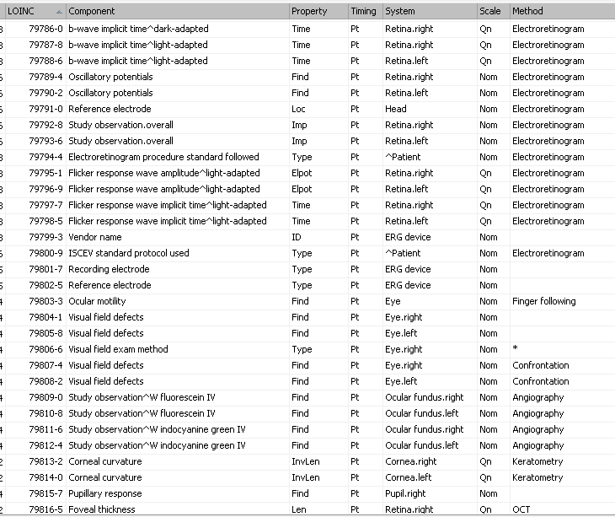
eyeGENE term examples

Slide 15
Cardiology terms
Two sources
DICOM – for Supplement 169 (“Simplified Adult Echocardiography Report”), based on American Society of Echocardiography guidelines
Japanese Circulation Society, for cardiac procedure result CDA implementation guides
~270 new terms
200 echo
70 angiography

Slide 16
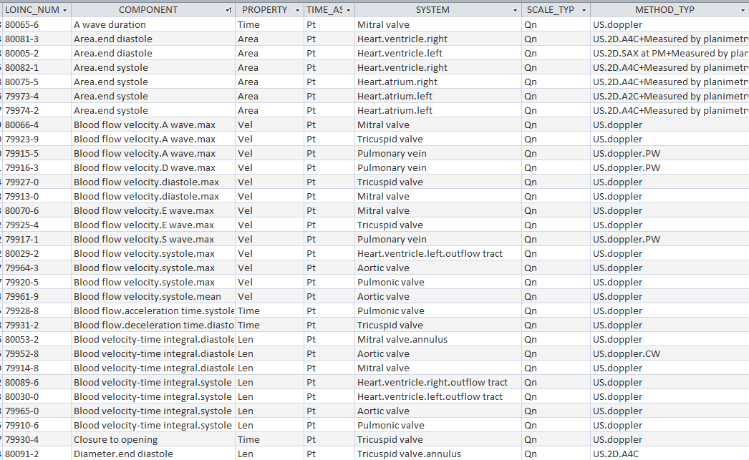
DICOM term examples

Slide 17
APTA update
American Physical Therapy Association’s Outcomes Registry panel finalized
Released as Trial in June 2015, changed to Active in 2.54 release
Includes new terms for two clinical assessments:
Boston University Activity Measure for Post-Acute Care (AM-PAC)
Care Connections Neuromuscular and Orthopedic functional index

Slide 18
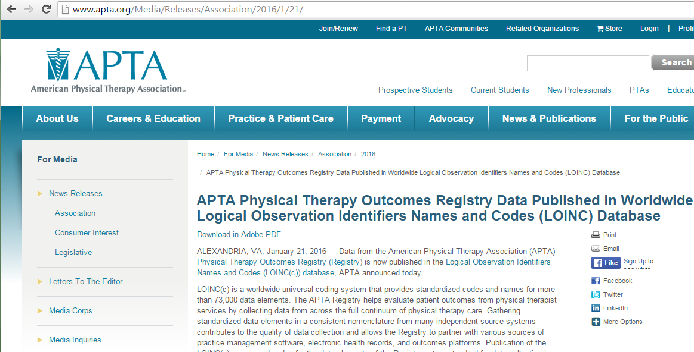
http://www.apta.org/Media/Releases/Association/2016/1/21/

Slide 19
~240 new survey terms
Panel of terms for 2015 Health IT Certification Criteria
170+ terms created for PROMIS short forms and item banks – nearly done updating LOINC content so that we are current with PROMIS content added post 2010
Terms for Vanderbilt ADHD Diagnostic Rating Scale created for NCQA quality measures
Score change terms for HOOS, KOOS and Veteran’s Rand (VR)
Terms for the General Practitioner Assessment of Cognition (GPCOG)

Slide 20
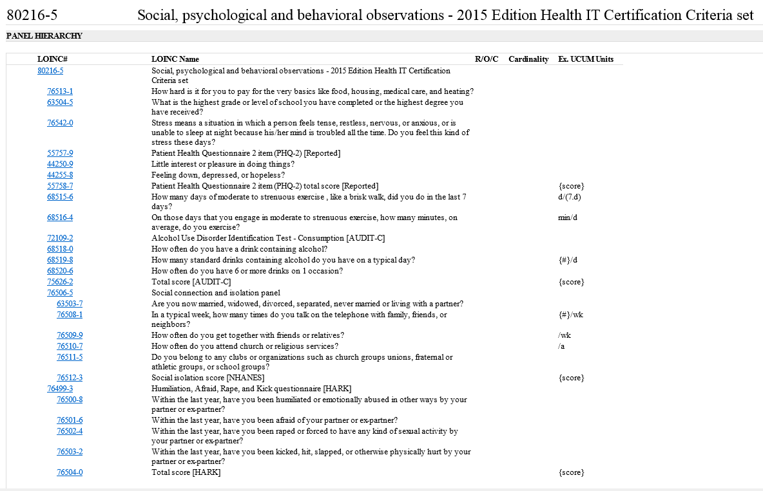

Slide 21
Highlights of content updates
Updated several hundred HLA terms according to the recommended nomenclature (http://hla.alleles.org/nomenclature/index.html)
Ongoing work with RSNA to establish a unified model for naming radiology terms
We implemented several more changes related to the CT domain that led to edits to over 100 existing radiology terms.
Plus 428 Radiology Long Common Names and Short names were updated for better readability
2016 – completed MRI, almost done with US
Peritoneal dialysis test terms, where the testing is performed during the dialysis procedure, were better described using challenge wording of 'Dwell' or 'Dwell specimen'
Over 2100 terms that specify a look-back period in the Component had the timing changed from 'Pt' to the specific time stated by the question. For example, timing changed from 'Pt' to ‘7D’ for terms that specify a look-back period of 7 days.

